Slide 1
LINKEDIN JOB ANALYSIS
PROJECT BY:
JAYMIN PAREKH – PD13_289
DIVYA DINESH YADAV – PD13_101
DEEPAK SONAWANE – PD13_110
SWAPNIL DEOGHATOLE – PD12_015

Slide 2




TASK:
Scrape data from professional networking platform Linkedin using python library called Beautifulsoup (or similar) and collate information in the given format and make tables using the data

Slide 3
STEP 1 – WEB SCRAPPING USING PYTHON
LIBRARIES USED:
1. PANDAS
2. BEAUTIFULSOUP
3. SELENIUM
REFERENCES USED:
1. https://pypi.org/project/beautifulsoup4/
2. https://beautiful-soup-4.readthedocs.io/en/latest/

Slide 4
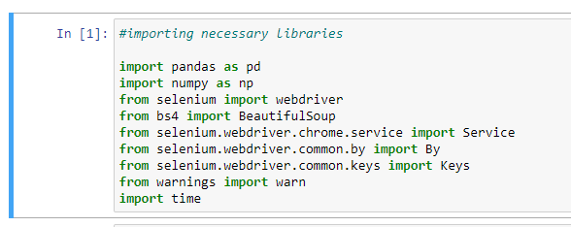

Slide 5
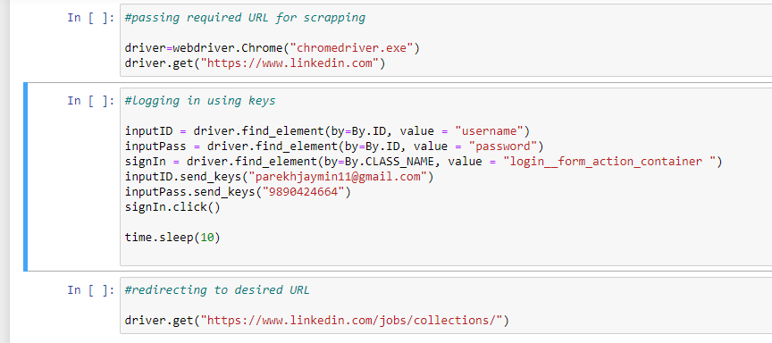

Slide 6
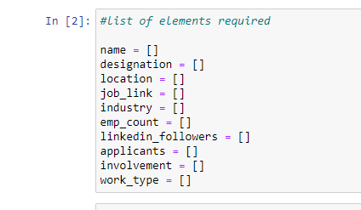

Slide 7
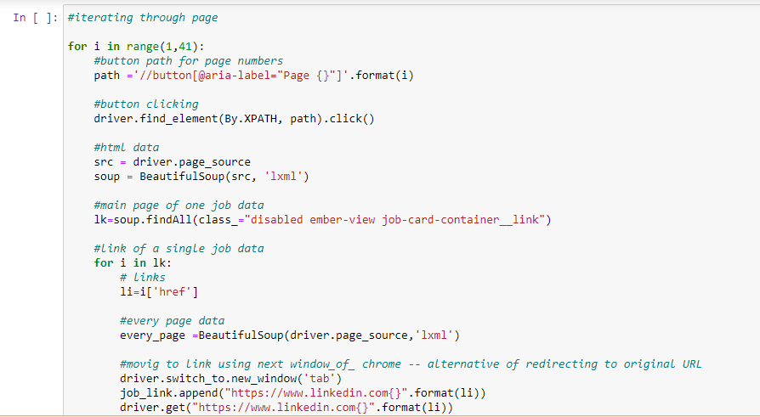

Slide 8
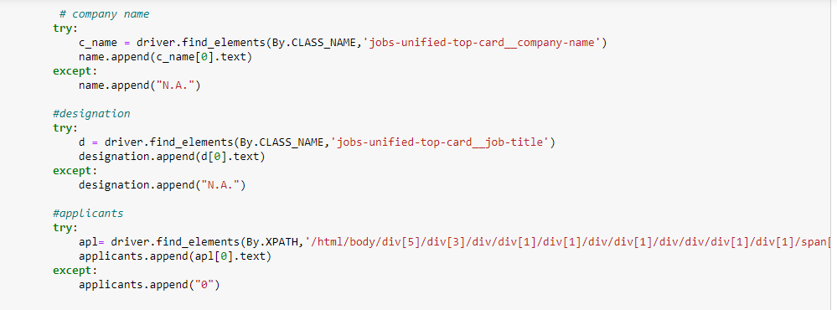

Slide 9
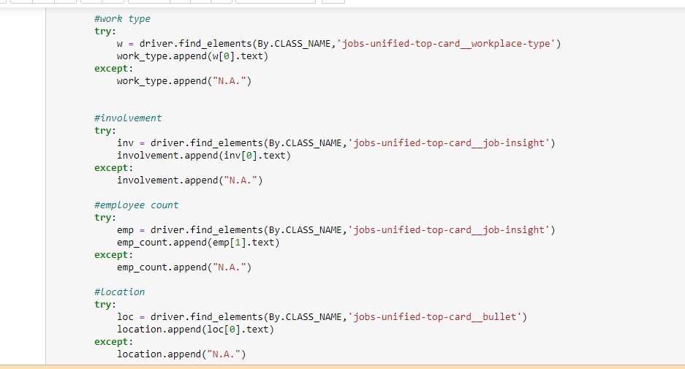

Slide 10
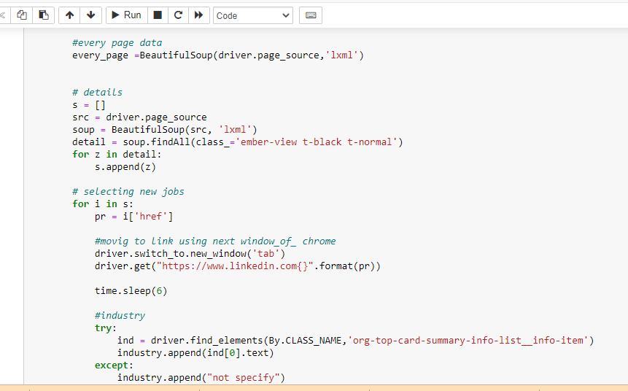

Slide 11
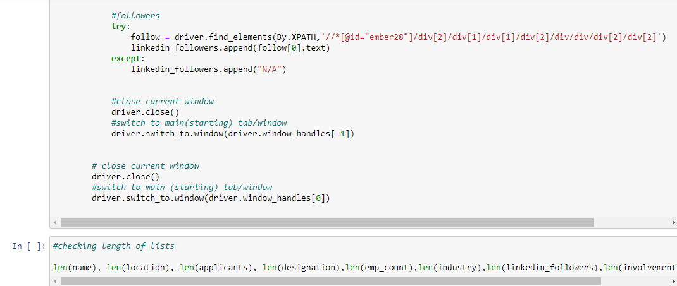

Slide 12
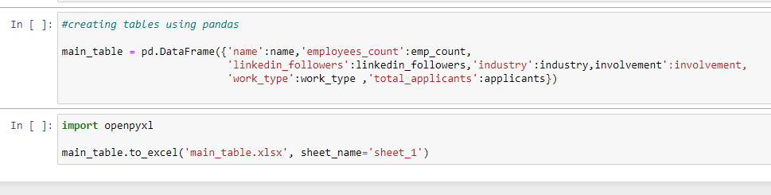
FINALLY MAKING A TABLE FROM LISTS USING PANDAS

Slide 13
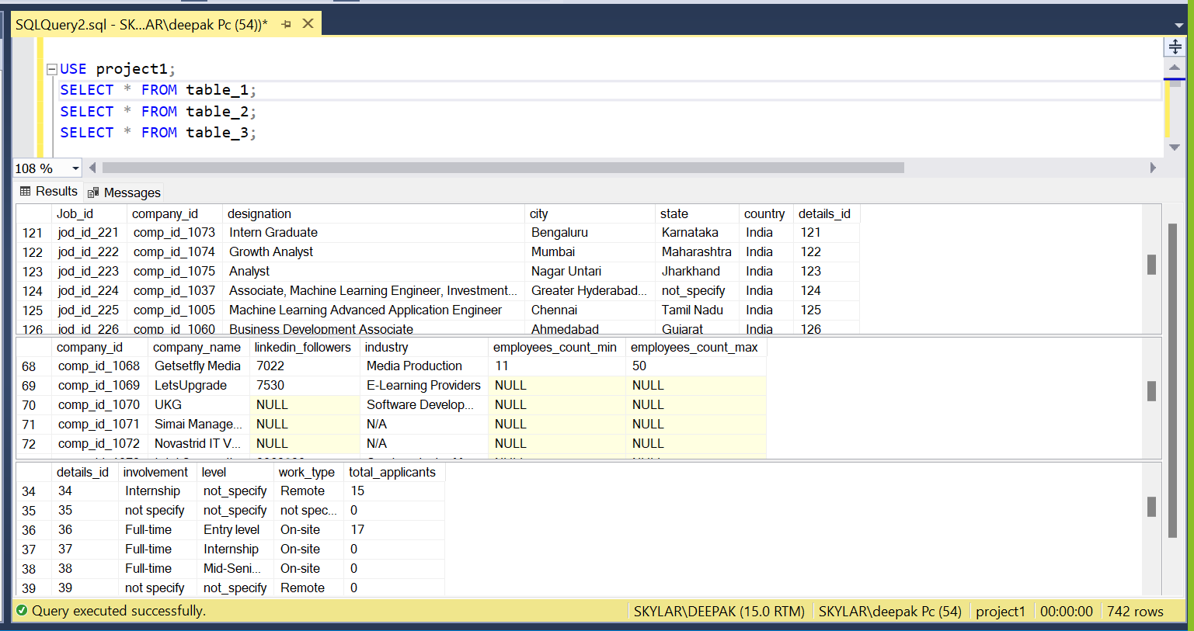
STEP 2 – USING MS SQL FOR TABLE CREATION

Slide 14
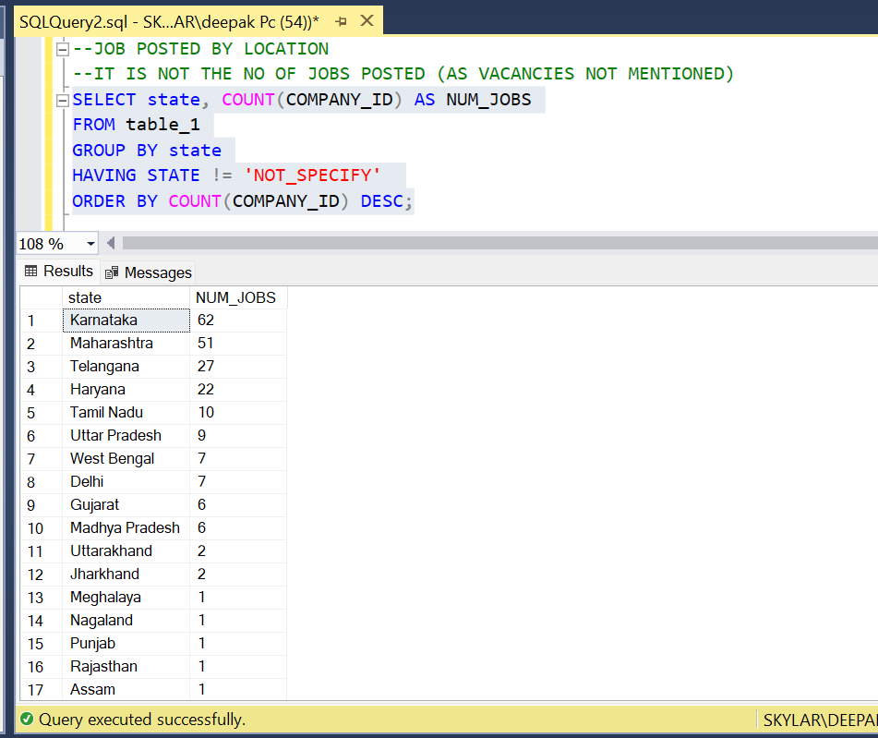

Slide 15
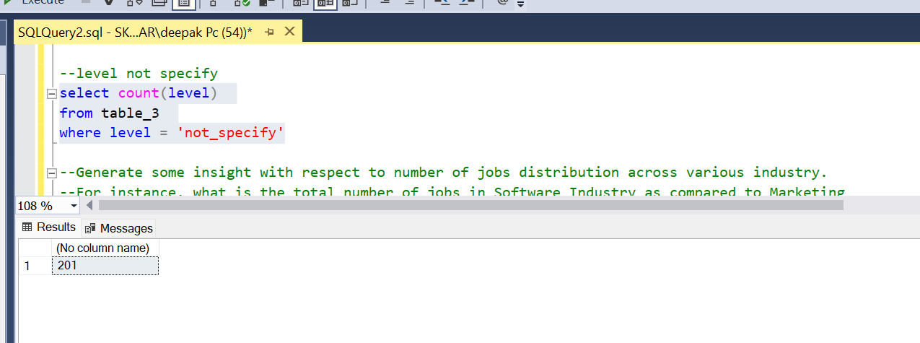

Slide 16
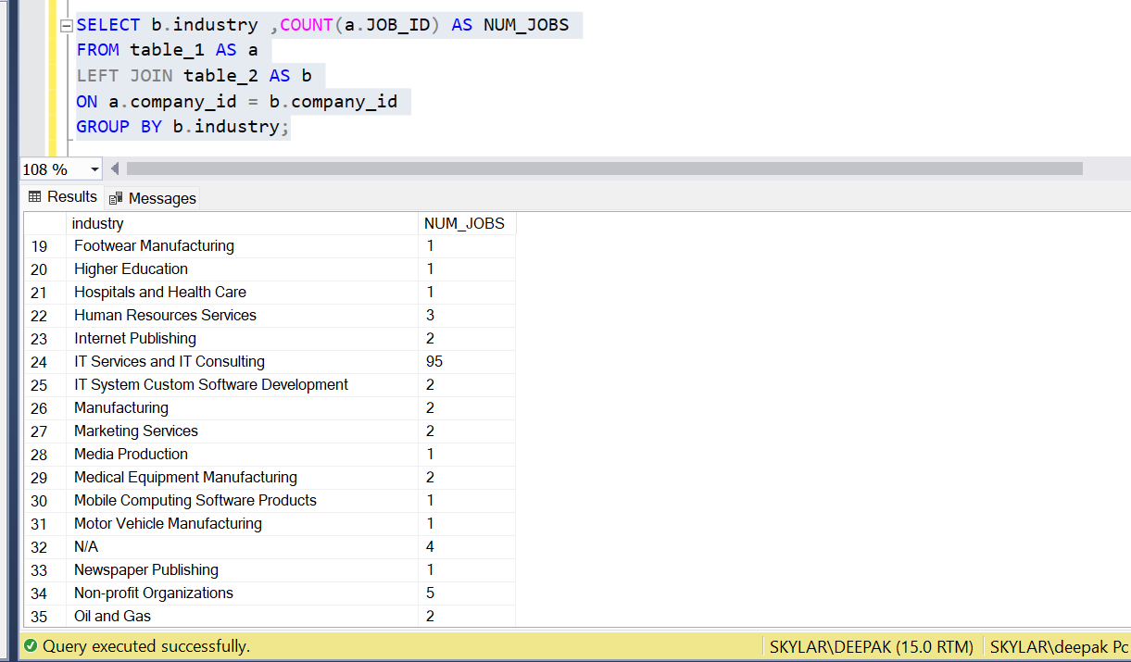

Slide 17
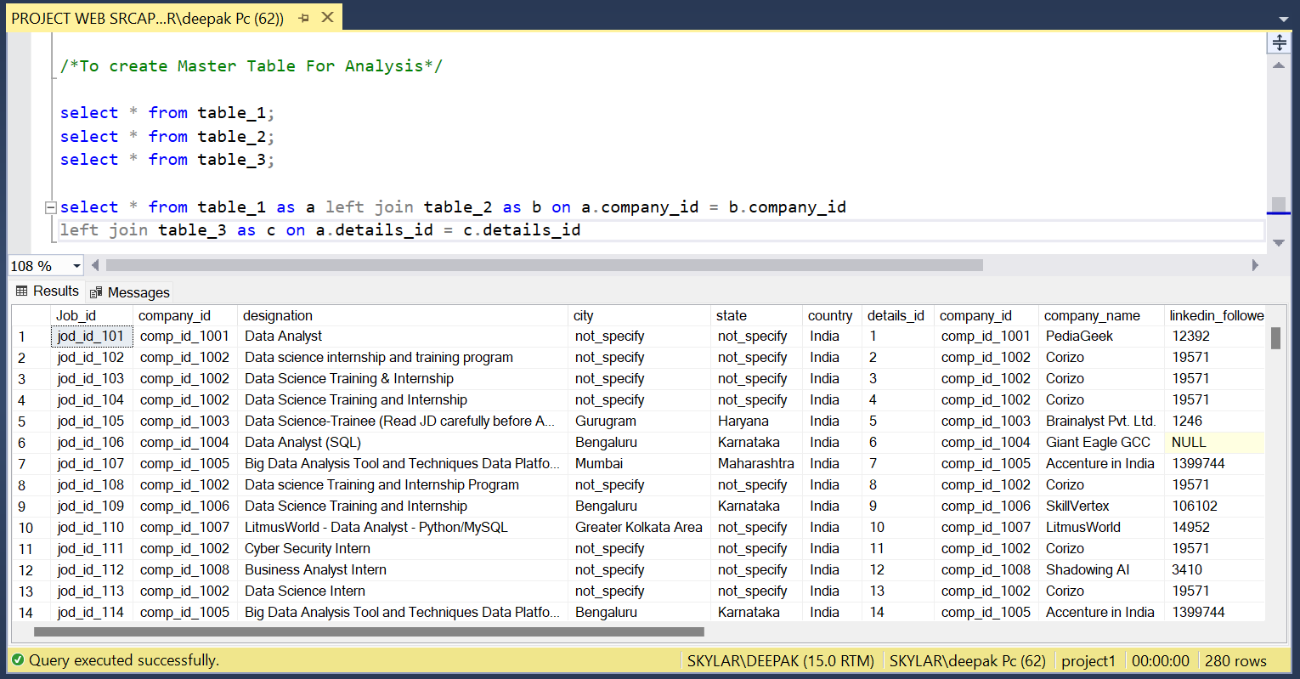
CREATING MASTER TABLE FOR TABLEAU

Slide 18
